Slide 1
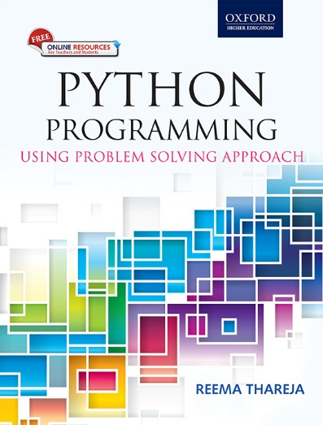
1
Python Programming
Using Problem Solving Approach
Reema Thareja

Slide 2
CHAPTER 6
Python Strings Revisited
© Oxford University Press 2017. All rights reserved.

Slide 3
Strings
Python treats strings as contiguous series of characters delimited by single, double or even triple quotes. Python has a built-in string class named "str" that has many useful features. We can simultaneously declare and define a string by creating a variable of string type. This can be done in several ways which are as follows:
name = "India" graduate = 'N' country = name nationality = str("Indian")
Indexing: Individual characters in a string are accessed using the subscript ([ ]) operator. The expression in brackets is called an index. The index specifies a member of an ordered set and in this case it specifies the character we want to access from the given set of characters in the string.
The index of the first character is 0 and that of the last character is n-1 where n is the number of characters in the string. If you try to exceed the bounds (below 0 or above n-1), then an error is raised.

Slide 4
Strings
Traversing a String: A string can be traversed by accessing character(s) from one index to another. For example, the following program uses indexing to traverse a string from first character to the last.
Example:

Slide 5
Concatenating, Appending and Multiplying Strings
Examples:

Slide 6
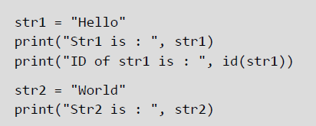
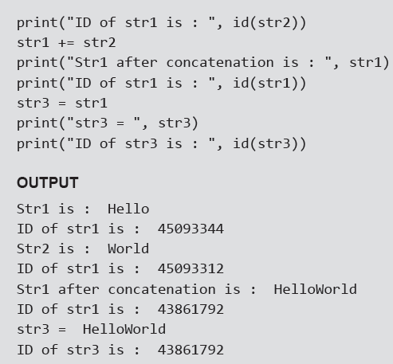
Strings are Immutable
Python strings are immutable which means that once created they cannot be changed. Whenever you try to modify an existing string variable, a new string is created.
Example:

Slide 7
String Formatting Operator
The % operator takes a format string on the left (that has %d, %s, etc) and the corresponding values in a tuple (will be discussed in subsequent chapter) on the right. The format operator, % allow users to construct strings, replacing parts of the strings with the data stored in variables. The syntax for the string formatting operation is:
"<Format>" % (<Values>)
Example:

Slide 8
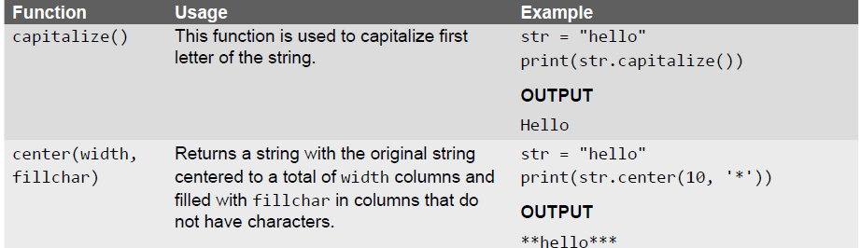
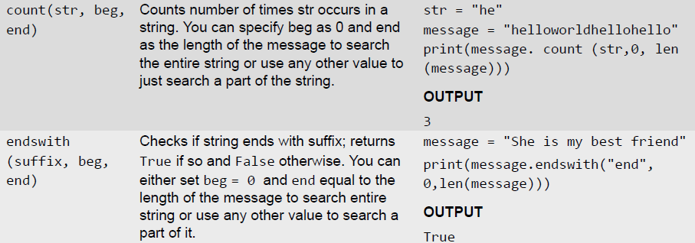
Built-in String Methods and Functions

Slide 9
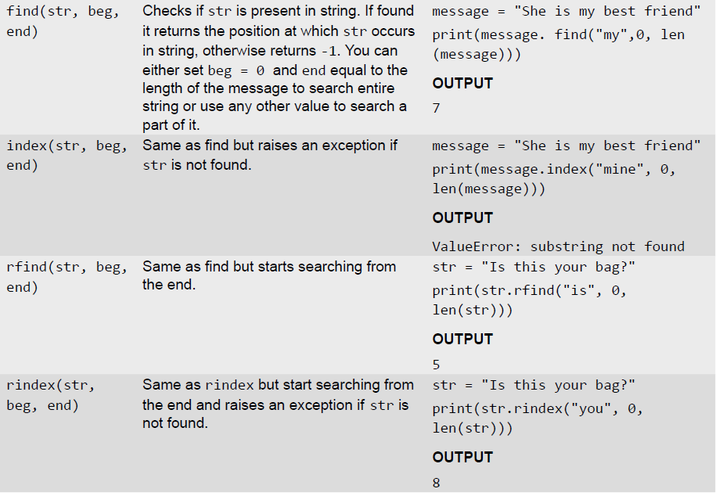
Built-in String Methods and Functions

Slide 10
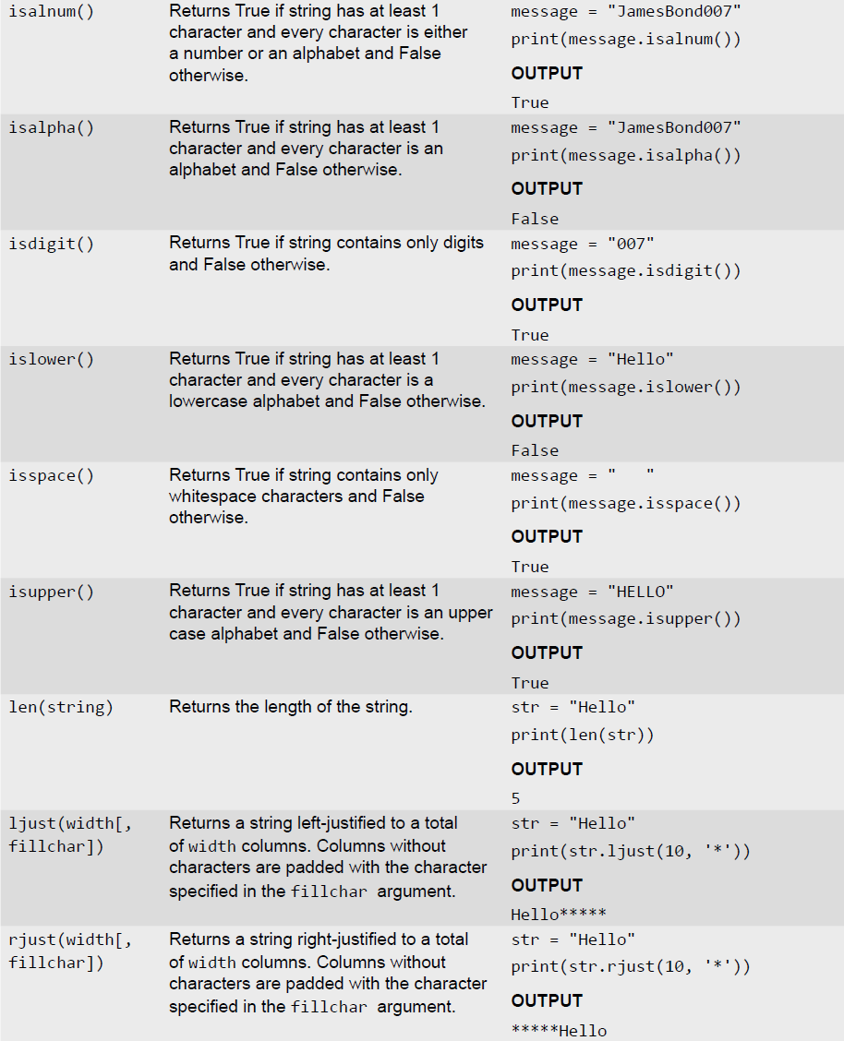
Built-in String Methods and Functions

Slide 11
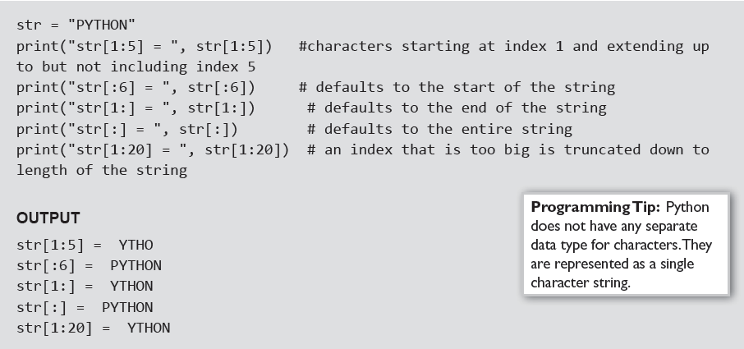
Slice Operation
A substring of a string is called a slice. The slice operation is used to refer to sub-parts of sequences and strings. You can take subset of string from original string by using [ ] operator also known as slicing operator.
Examples:

Slide 12
Specifying Stride while Slicing Strings
In the slice operation, you can specify a third argument as the stride, which refers to the number of characters to move forward after the first character is retrieved from the string. By default the value of stride is 1, so in all the above examples where he had not specified the stride, it used the value of 1 which means that every character between two index numbers is retrieved.
Examples:

Slide 13
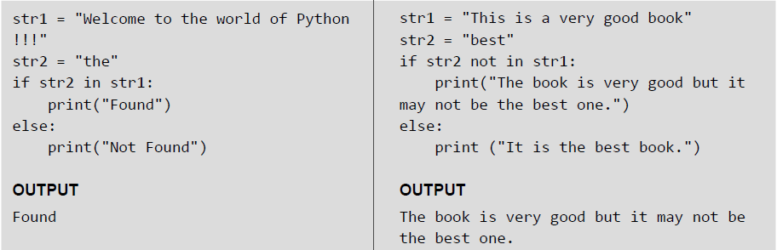
ord() and chr() Functions
ord() function returns the ASCII code of the character and chr() function returns character represented by a ASCII number.
Examples:
in and not in Operators
in and not in operators can be used with strings to determine whether a string is present in another string. Therefore, the in and not in operator are also known as membership operators.
Examples:

Slide 14
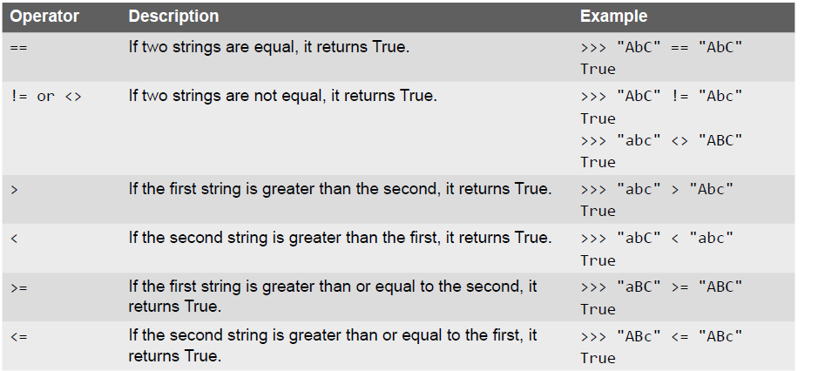
Comparing Strings

Slide 15
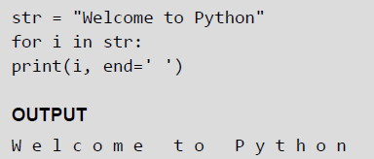
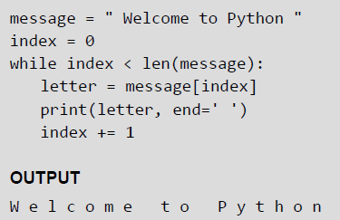
Iterating String
String is a sequence type (sequence of characters). You can iterate through the string using for loop.
Examples:

Slide 16
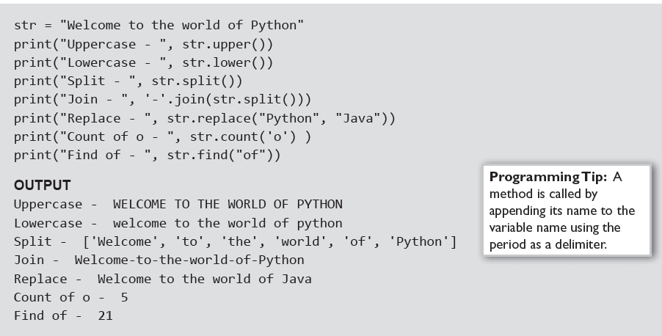
The String Module
The string module consist of a number of useful constants, classes and functions (some of which are deprecated). These functions are used to manipulate strings.
Examples:

Slide 17
Working with Constants in String Module
You can use the constants defined in the string module along with the find function to classify characters. For example, if find(lowercase, ch) returns a value except -1, then it means that ch must be a lowercase character. An alternate way to do the same job is to use the in operator or even the comparison operation.
Examples:
© Oxford University Press 2017. All rights reserved.

Slide 18
Regular Expressions
Regular Expressions are a powerful tool for various kinds of string manipulation. These are basically a special text string that is used for describing a search pattern to extract information from text such as code, files, log, spreadsheets, or even documents.
Regular expressions are a domain specific language (DSL) that is present as a library in most of the modern programming languages, besides Python. A regular expression is a special sequence of characters that helps to match or find strings in another string. In Python, regular expressions can be accessed using the re module which comes as a part of the Standard Library
The Match Function
As the name suggest, the match() function matches a pattern to string with optional flags. The syntax of match() function is,
re.match (pattern, string, flags=0)

Slide 19
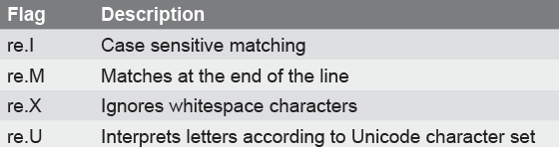
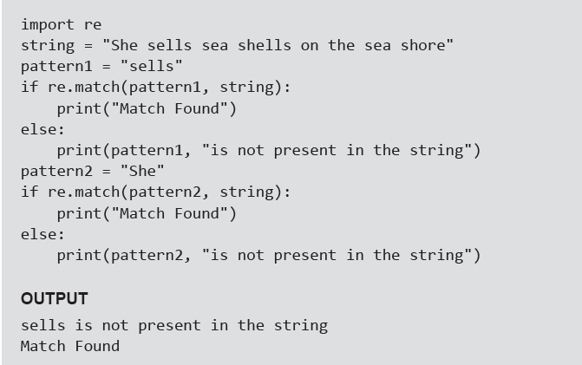
EXAMPLE- Match() Function
Examples:

Slide 20
The search Function
The search() function in the re module searches for a pattern anywhere in the string. Its syntax of can be given as, re.search(pattern, string, flags=0)
The syntax is similar to the match() function. The function searches for first occurrence of pattern within a string with optional flags. If the search is successful, a match object is returned and None otherwise.
Example:

Slide 21
The sub() Function
The sub() function in the re module can be used to search a pattern in the string and replace it with another pattern. The syntax of sub() function can be given as, re.sub(pattern, repl, string, max=0)
According to the syntax, the sub() function replaces all occurrences of the pattern in string with repl, substituting all occurrences unless any max value is provided. This method returns modified string.
Example:

Slide 22
The findall() and finditer() Function
The findall() function is used to search a string and returns a list of matches of the pattern in the string. If no match is found, then the returned list is empty. The syntax of match() function can be given as,
matchList = re.findall(pattern, input_str, flags=0)
Examples:

Slide 23
Flag Options
The search(), findall() and match() functions of the module take options to modify the behavior of the pattern match. Some of these flags are:
re.I or re.IGNORECASE — Ignores case of characters, so "Match", "MATCH", "mAtCh", etc are all same
re.S or re.DOTALL — Enables dot (.) to match newline. By default, dot matches any character other than the newline character.
re.M or re.MULTILINE — Makes the ^ and $ to match the start and end of each line. That is, it matches even after and before line breaks in the string. By default, ^ and $ matches the start and end of the whole string.
re.L or re.LOCALE- Makes the flag \w to match all characters that are considered letters in the given current locale settings.
re.U or re.UNICODE- Treats all letters from all scripts as word characters.

Slide 24
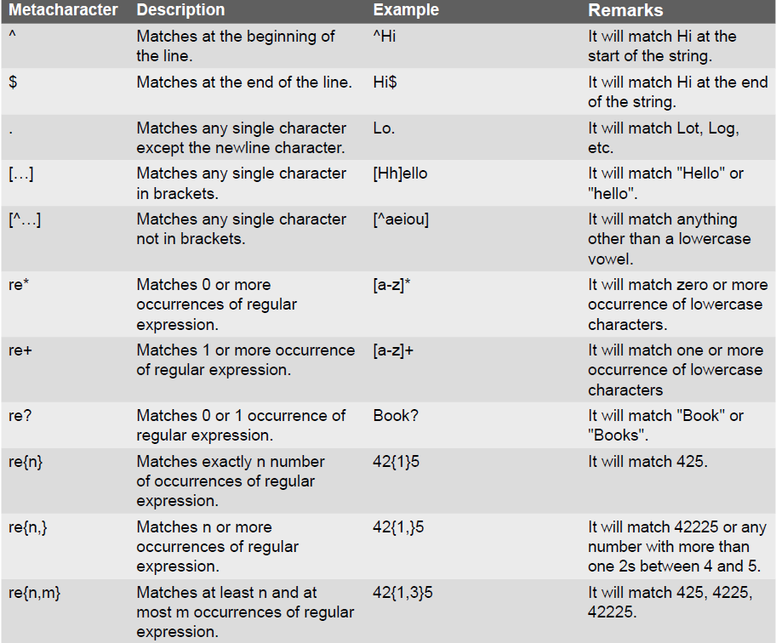
Metacharacters in Regular Expression
© Oxford University Press 2017. All rights reserved.

Slide 25
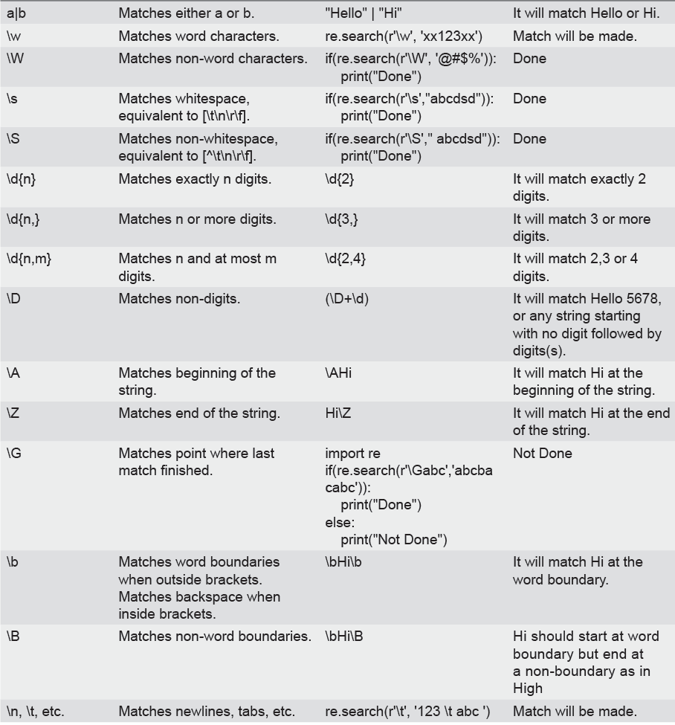
Metacharacters in Regular Expression
© Oxford University Press 2017. All rights reserved.

Slide 26
Character Classes
When we put the characters to be matched inside square brackets, we call it a character class. For example, [aeiou] defines a character class that has a vowel character.
Examples:

Slide 27
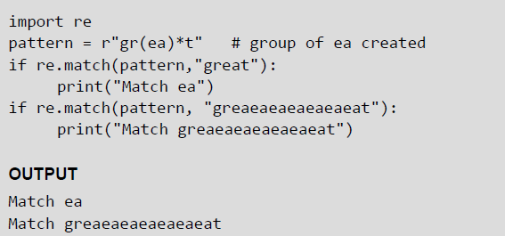
Groups
A group is created by surrounding a part of the regular expression with parentheses. You can even give group as an argument to the metacharacters such as * and ?.
Example:
The content of groups in a match can be accessed by using the group() function. For example,
group(0) or group() returns the whole match.
group(n), where n is greater than 0, returns the nth group from the left.
group() returns all groups up from 1.
© Oxford University Press 2017. All rights reserved.

